Slide 1
A Project On Consumer Behavior &Brand Perception
Objective:
The primary objective of this project is to analyze and understand consumer behavior and brand perception by examining various factors that influence purchasing decisions.
By exploring data related to customer demographics, brand preferences, buying patterns, and customer feedback, this analysis aims to uncover key insights that can guide businesses in enhancing brand loyalty, improving customer engagement, and developing targeted marketing strategies.

Slide 2
Data Sets :
dim_respondent
dim_cities
Using `City_ID`, I merged the dimensions
`dim_respondent` and `dim_city` with pandas.
fact_survey_responses
Using Respondent_ID merged the dimensions with pandas.

Slide 3
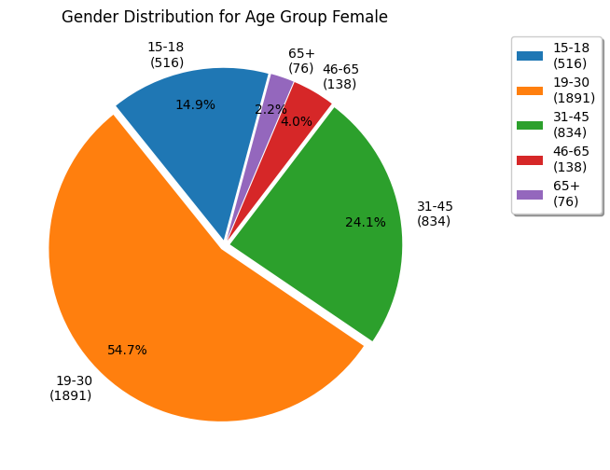

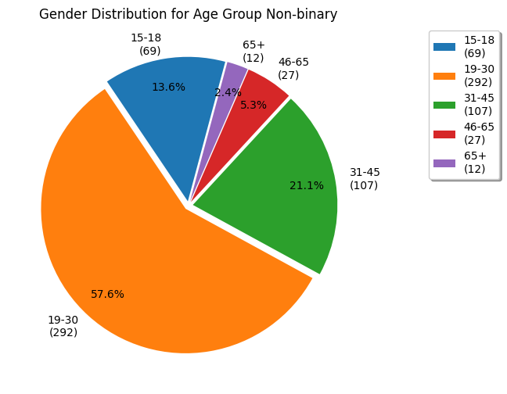
Gender Distribution Across Different Age Groups
Female Participation: Females are significantly fewer than males in each age group, with the highest female count in the 19-30 age group (1,891).
Male Dominance Across All Ages: Males consistently have the highest numbers across all age groups, particularly in the 19-30 age group, which has the largest male population at 3,337.
Non-Binary Representation: Non-binary individuals are present in all age groups but in much smaller numbers, peaking in the 19-30 age group with 292 participants.

Slide 4
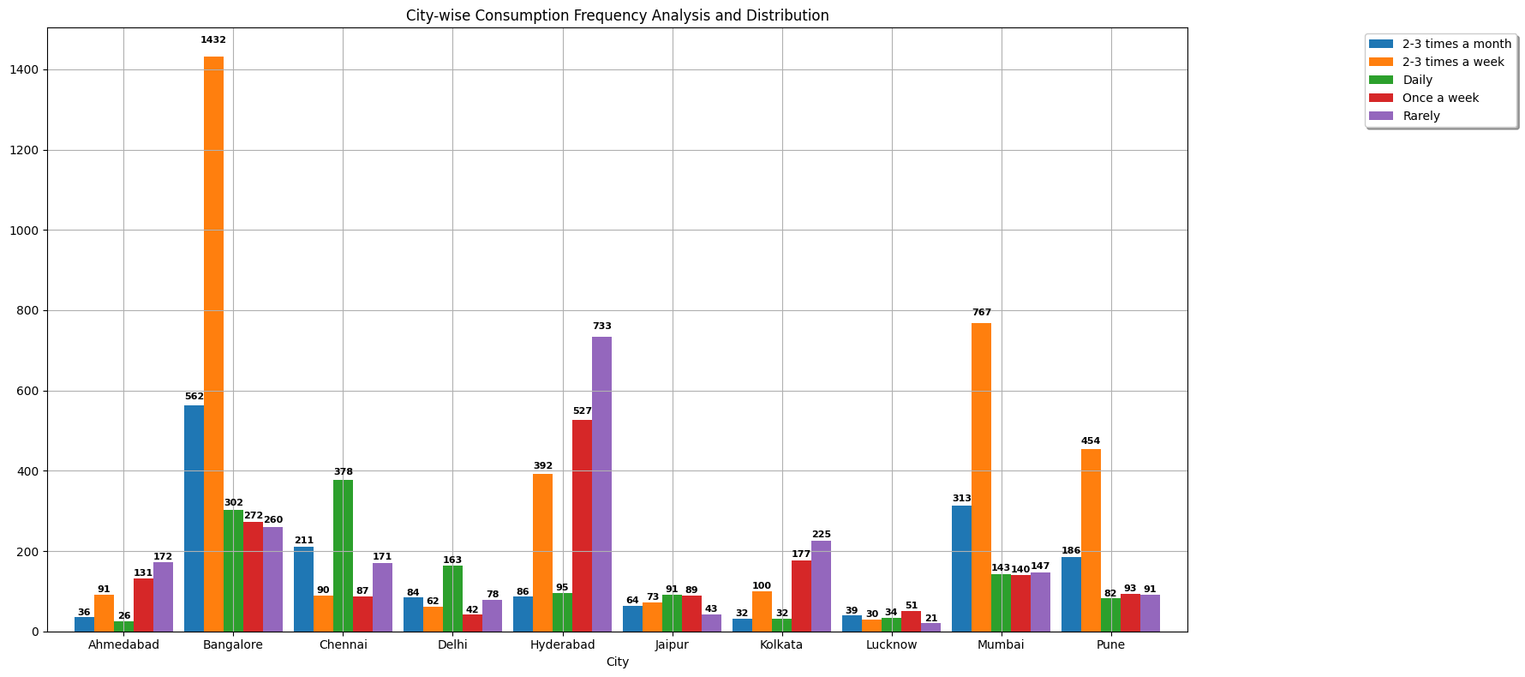
City-wise Consumption Frequency Analysis and Distribution
High Weekly Consumption in Bangalore: Bangalore leads in frequent consumption, with the highest counts in both the "2-3 times a week" and "Daily" categories, indicating a strong consumer base for regular usage.
Varied Patterns Across Cities:
Ahmedabad and Mumbai have more balanced consumption patterns, with significant participation across all frequency categories.
Chennai has a notably high daily consumption compared to its other categories, highlighting a strong daily user base.
Lower Consumption in Smaller Cities: Cities like Lucknow and Jaipur have lower overall consumption frequencies, with most participants consuming products "Rarely" or "Once a week."

Slide 5
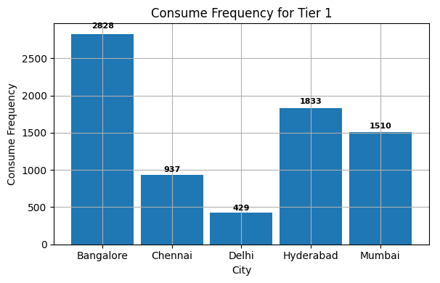
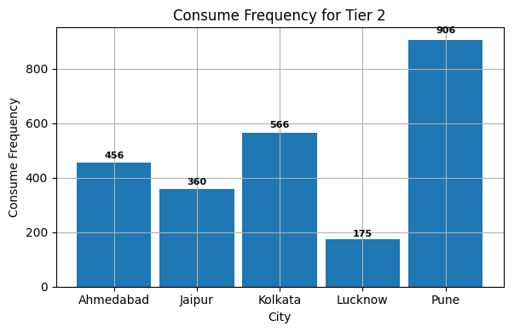
Consumer Distribution based on TIER
Tier 1 Dominance: Cities like Bangalore, Chennai, Delhi, Hyderabad, and Mumbai show a strong presence in Tier 1, with Bangalore leading at 2,828.
Tier 2 Presence: Ahmedabad, Jaipur, Kolkata, Lucknow, and Pune are prominent in Tier 2, with Kolkata having the highest count at 566.

Slide 6
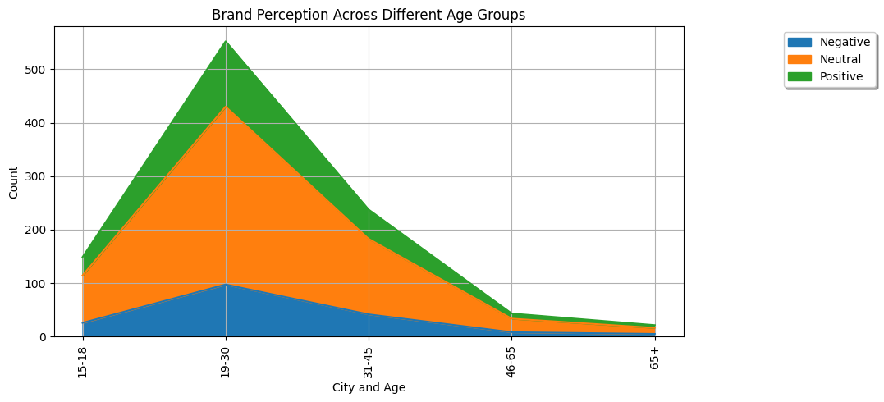
Brand Perception Across Different Age Groups
Neutral Perception Dominates: Across all age groups, the majority of individuals hold a neutral perception of the brand, with the highest numbers seen in the 19-30 age group (332.30).
Positive Perception: Positive brand perception is the second most common, particularly strong in the 19-30 age group (122.1), followed by the 31-45 age group (54.7).
Negative Perception: Negative perception is the least prevalent across all age groups, with the 19-30 age group still leading in numbers (97.6), though significantly lower than neutral and positive perceptions.

Slide 7
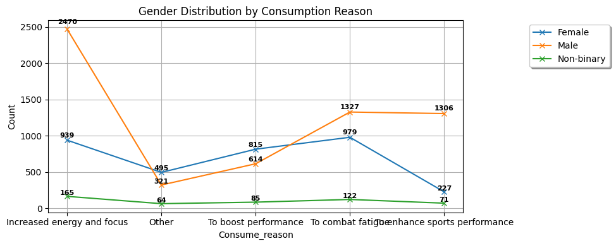
Gender Distribution by Consumption Reason
Males are the primary consumers of energy drinks, especially for focus, fatigue, and sports performance.
Females and non-binary individuals also consume energy drinks, but for different reasons and at lower rates.

Slide 8
Identified Trends
Age Distribution: The 19-30 age group is the largest, comprising 55.2% of the data, with a strong preference for consuming energy drinks "2-3 times a week."
Gender Distribution: Males dominate at 60.38%, followed by females at 27.12%, and non-binary individuals at 12.5%.
City Distribution: Bangalore leads as the most mentioned city, accounting for 28.28% of the data.
Consumption Frequency: "2-3 times a week" is the most common consumption frequency, indicating regular use among consumers.
Brand Perception: "Neutral" is the most common brand perception, though there's significant interest in products labeled "Effective" and "Reduced sugar content."
Marketing Channels: Online ads are the leading marketing channel, noted by 60.45% of respondents.

Slide 9
Suggestions for Improvement:
Diversify Audience:
Target more diverse age groups and cities with focused marketing to broaden reach.
Enhance Brand Perception:
Improve product effectiveness and reduce sugar content to shift perceptions more positively.
Optimize Marketing:
While online ads are effective, also explore social media and influencer partnerships to reach new segments.
Improve Availability:
Ensure products are available locally and explore regional distribution to reduce purchase barriers.
Leverage Feedback:
Use consumer feedback to tailor products and marketing, aligning with customer expectations.
These strategies can boost consumer satisfaction, expand market presence, and improve brand performance.

Slide 10
THANK YOU

